Slide 1



Slide 2
Secure coding is no longer an option
Always assume that someone is going to try to attack your application
Open Web Application Security Project is an open source application security community with the goal to improve the security of software.
Every year they issue their ‘top 10’ security vulnerabilities
SANS institute (SysAdmin, Audit, Network and Security) is a cooperative research and education organisation that specialises in information security and cybersecurity training.
The SANS Top 25 Most Dangerous Software Errors is a list of the most widespread and critical errors that can lead to serious vulnerabilities in software.
Notes:
SANS institute Internet Storm Centre - Survival time on the internet – 4 minutes for an unpatched Windows box to get compromised (Win8)

Slide 3

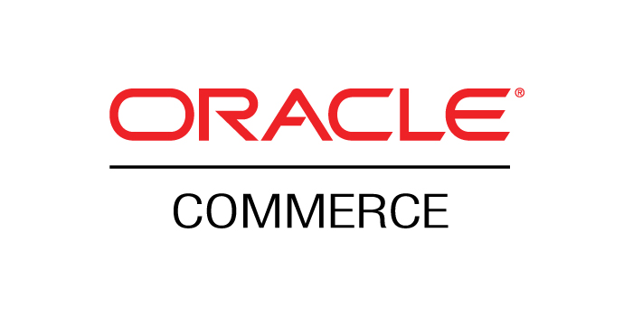
Why does Alan Tyler know about this?
Head of Application Development
Development Manager Oracle Commerce UK

Slide 4
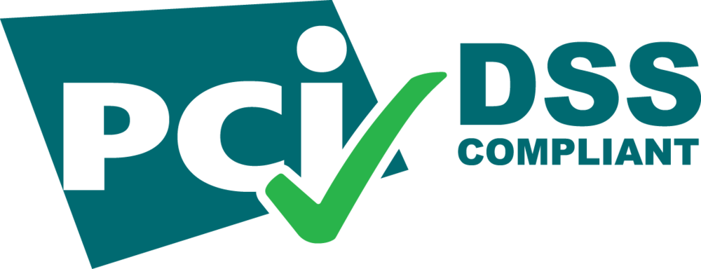
Both roles required PCI DSS (Payment Card Industry Data Security Standard) compliance.
Very strict set of rules and regulations that must be adhered to
Annual audit from a Qualified Security Assessor (QSA)
All developers had to demonstrate knowledge of the OWASP top 10, and show in their code how each vulnerability was countered.

Slide 5
This is the current top 10:
Injection
Broken Authentication
Sensitive Data Exposure
XML External Entities
Broken Access Control
Security Misconfiguration
Cross-Site Scripting
Insecure Deserialisation
Using Components with Known Vulnerabilities
Insufficient Logging and Monitoring

Slide 6
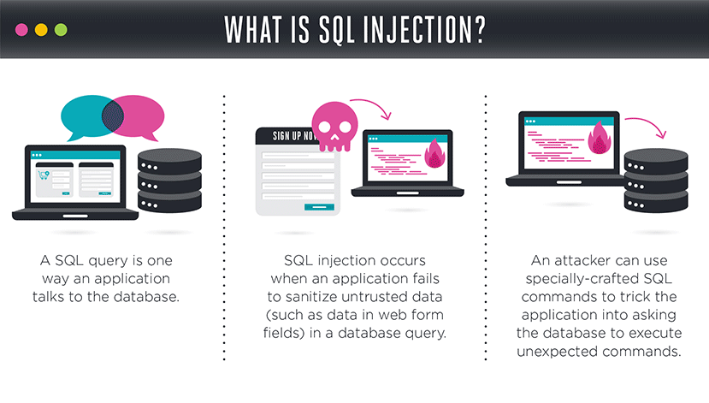
1. SQL Injection
Notes:
SQL injection (SQLi) is an application security weakness that allows attackers to control an application’s database – letting them access or delete data, change an application’s data-driven behavior, and do other undesirable things – by tricking the application into sending unexpected SQL commands.
SQL injection weaknesses occur when an application uses untrusted data, such as data entered into web form fields, as part of a database query. When an application fails to properly sanitize this untrusted data before adding it to a SQL query, an attacker can include their own SQL commands which the database will execute. Such SQLi vulnerabilities are easy to prevent, yet SQLi remains a leading web application risk, and many organizations remain vulnerable to potentially damaging data breaches resulting from SQL injection.

Slide 7
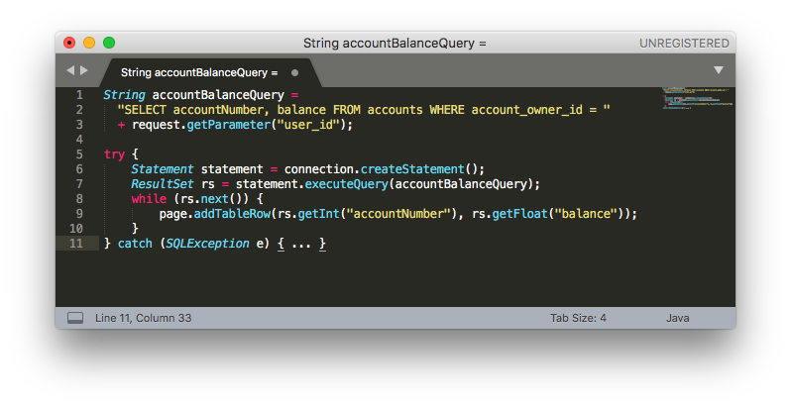
Imagine a developer needs to show the account numbers and balances for the current user’s id as provided in a URL. They might write (in Java):
Under normal operation, the user with ID 984 might be logged in, and visit the URL: https://bankingwebsite/show_balances?user_id=984

Slide 8
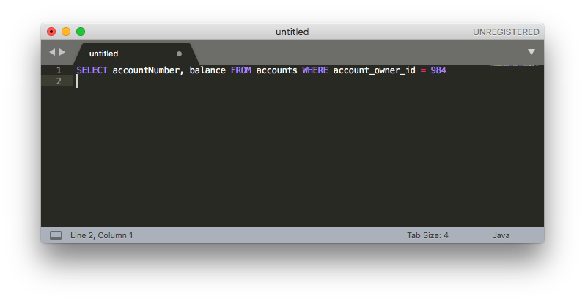
This means that accountBalanceQuery would end up being:
This is passed to the database, and the accounts and balances for user 984 are returned, and rows are added to the page to show them.
The attacker could change the parameter “user_id” to be interpreted as:
0 OR 1=1

Slide 9
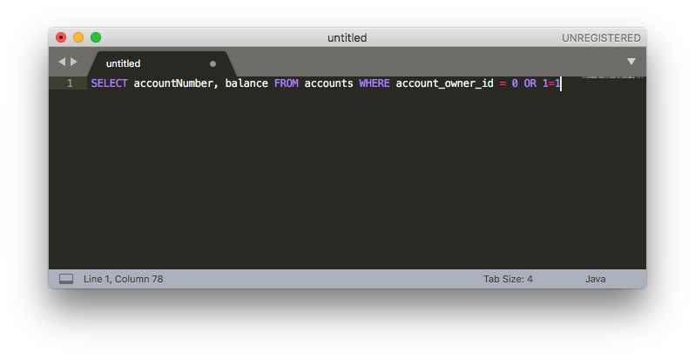
This results in accountBalanceQuery being:
When this query is passed to the database, it will return all the account numbers and balances it has stored, and rows are added to the page to show them. The attacker now knows every user’s account numbers and balances.

Slide 10
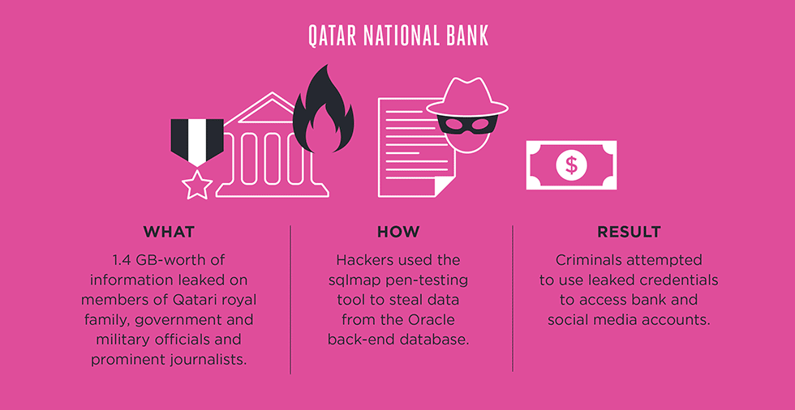

Slide 11
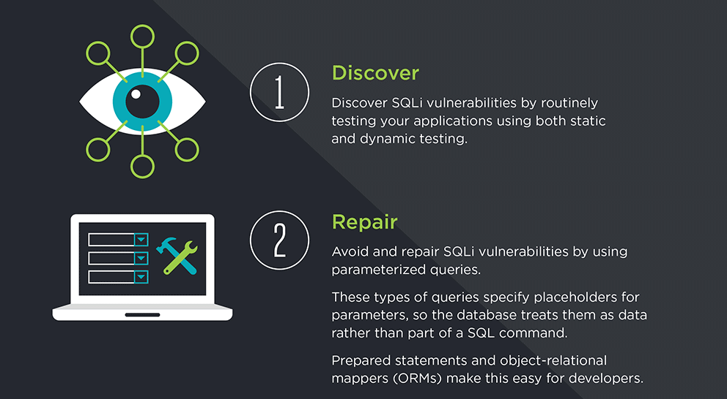
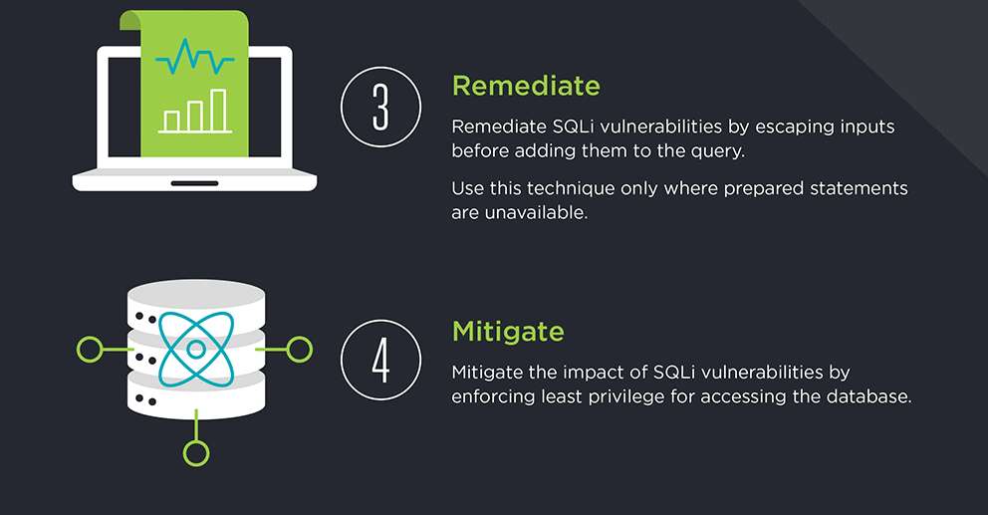

Slide 12
2.Broken Authentication
These types of weaknesses can allow an attacker to either capture or bypass the authentication methods that are used by a web application.
User authentication credentials are not protected when stored.
Predictable login credentials.
Session IDs are exposed in the URL (e.g., URL rewriting).
Session IDs are vulnerable to session fixation attacks.
Session value does not timeout or does not get invalidated after logout.
Session IDs are not rotated after successful login.
Passwords, session IDs, and other credentials are sent over unencrypted connections.
The goal of an attack is to take over one or more accounts and for the attacker to get the same privileges as the attacked user.

Slide 13
Example #1: URL rewriting:
http://example.com/sale/saleitems;jsessionid=2P0OC2JSNDLPSKHCJUN2JV?dest=Hawaii
An authenticated user of the site wants to let their friends know about the sale. The user e-mails the link above without realizing they are also giving away their session ID. When the friends use the link they use the user’s session and credit card.
Example #2: Application’s timeout is not set properly
The user utilizes a public computer to access a site. Instead of selecting “logout” the user simply closes the browser tab and walks away. An attacker uses the same browser an hour later, and that browser is still authenticated.
Example #3: Passwords are not properly hashed and salted
An insider or external attacker gains access to the system’s password database. User passwords are not properly hashed and salted, exposing every user’s password.
Stored username and password values should be salted and hashed, in addition to being encrypted.
Notes:
2011 Sony PSN hack – 77m user accounts compromised. Estimated cost to Sony of £105m

Slide 14
Example #4: Predictable login credentials
Username and Password values that are easy to guess or that are used frequently can be guessed by attackers to obtain unauthorized access.
Example #5: Username/Password Enumeration
Authentication failure responses should not indicate which part of the authentication data was incorrect. For example, instead of "Invalid username" or "Invalid password", just use "Invalid username and/or password" for both.
Example #6: Protection against brute force login
Enforce temporary account disabling after an established number of invalid login attempts (e.g., five attempts is common). The account must be disabled for a period of time sufficient to discourage brute force guessing of credentials, but not so long as to allow for a denial-of-service attack to be performed.

Slide 15
3. Sensitive Data Exposure
Occurs when an application or program, like a smartphone app or a browser, does not adequately protect information such as passwords, payment info, or health data.
With this information, cybercriminals can make fraudulent purchases, access a victim’s personal accounts, or even personal blackmail.
Average cost to a company in 2017 for allowing sensitive data to become exposed was $3.62m

Slide 16
It’s easily prevented!
Install an SSL certificate.
Never store or transmit data in clear text.
Keep a backup of the stored data separate from your web servers.
Use strong, unique passwords.
Use a web application firewall

Slide 17
4. XML External Entities
A specific type of Server-side Request Forgery (SSRF) attack, whereby an attacker is able to cause Denial of Service (DoS) and / or access local or remote files and services, by abusing a widely available, rarely used feature in XML parsers.
Malicious code is put into the XML Data Type Definition (DTD)

Slide 18
For example:
Request POST http://example.com/xml HTTP/1.1 <!DOCTYPE foo [ <!ELEMENT foo ANY> <!ENTITY bar "World"> ]> <foo> Hello &bar; </foo> | Response HTTP/1.0 200 OK Hello World

Slide 19
’Billion laughs’ XML Bomb:
POST http://example.com/xml HTTP/1.1 <!DOCTYPE foo [ <!ELEMENT foo ANY> <!ENTITY bar "World "> <!ENTITY t1 "&bar;&bar;"> <!ENTITY t2 "&t1;&t1;&t1;&t1;"> <!ENTITY t3 "&t2;&t2;&t2;&t2;&t2;"> ]> <foo> Hello &t3; </foo> | Response HTTP/1.0 200 OK Hello World World World World World World World World World World World World World World World World World World World World World World World World World World World World World World World World World World World World World World World World
Let entityOne be defined as of 20 entityTwo's, which themselves are defined as 20 entityThree's. If we continue in the same pattern until entityEight, the XML parser will unfold a single occurrence of entityOne to 1 280 000 000 entityEight's — taking up 5 GiB of memory. The ultimate goal of the attack is to deny service to a (web) application.
Notes:
Gibibyte
Prevention – disable xml external entities, or if you have to use them then validate all xml before it is parsed

Slide 20
5. Broken Access Control
Bypassing verification of access control by changing the URL or internal application state
Privilege escalation - Acting as an administrator when logged in as another user
Metadata manipulation with tampering or replaying to elevate privileges
CORS (Cross-Origin Resource Sharing) misconfiguration permits unauthorized access to the API
Happens when there’s no restriction from viewing or modifying someone else’s record or account
Common in applications and APIs where all user request privileges are not verified
Easy to detect with manual testing

Slide 21
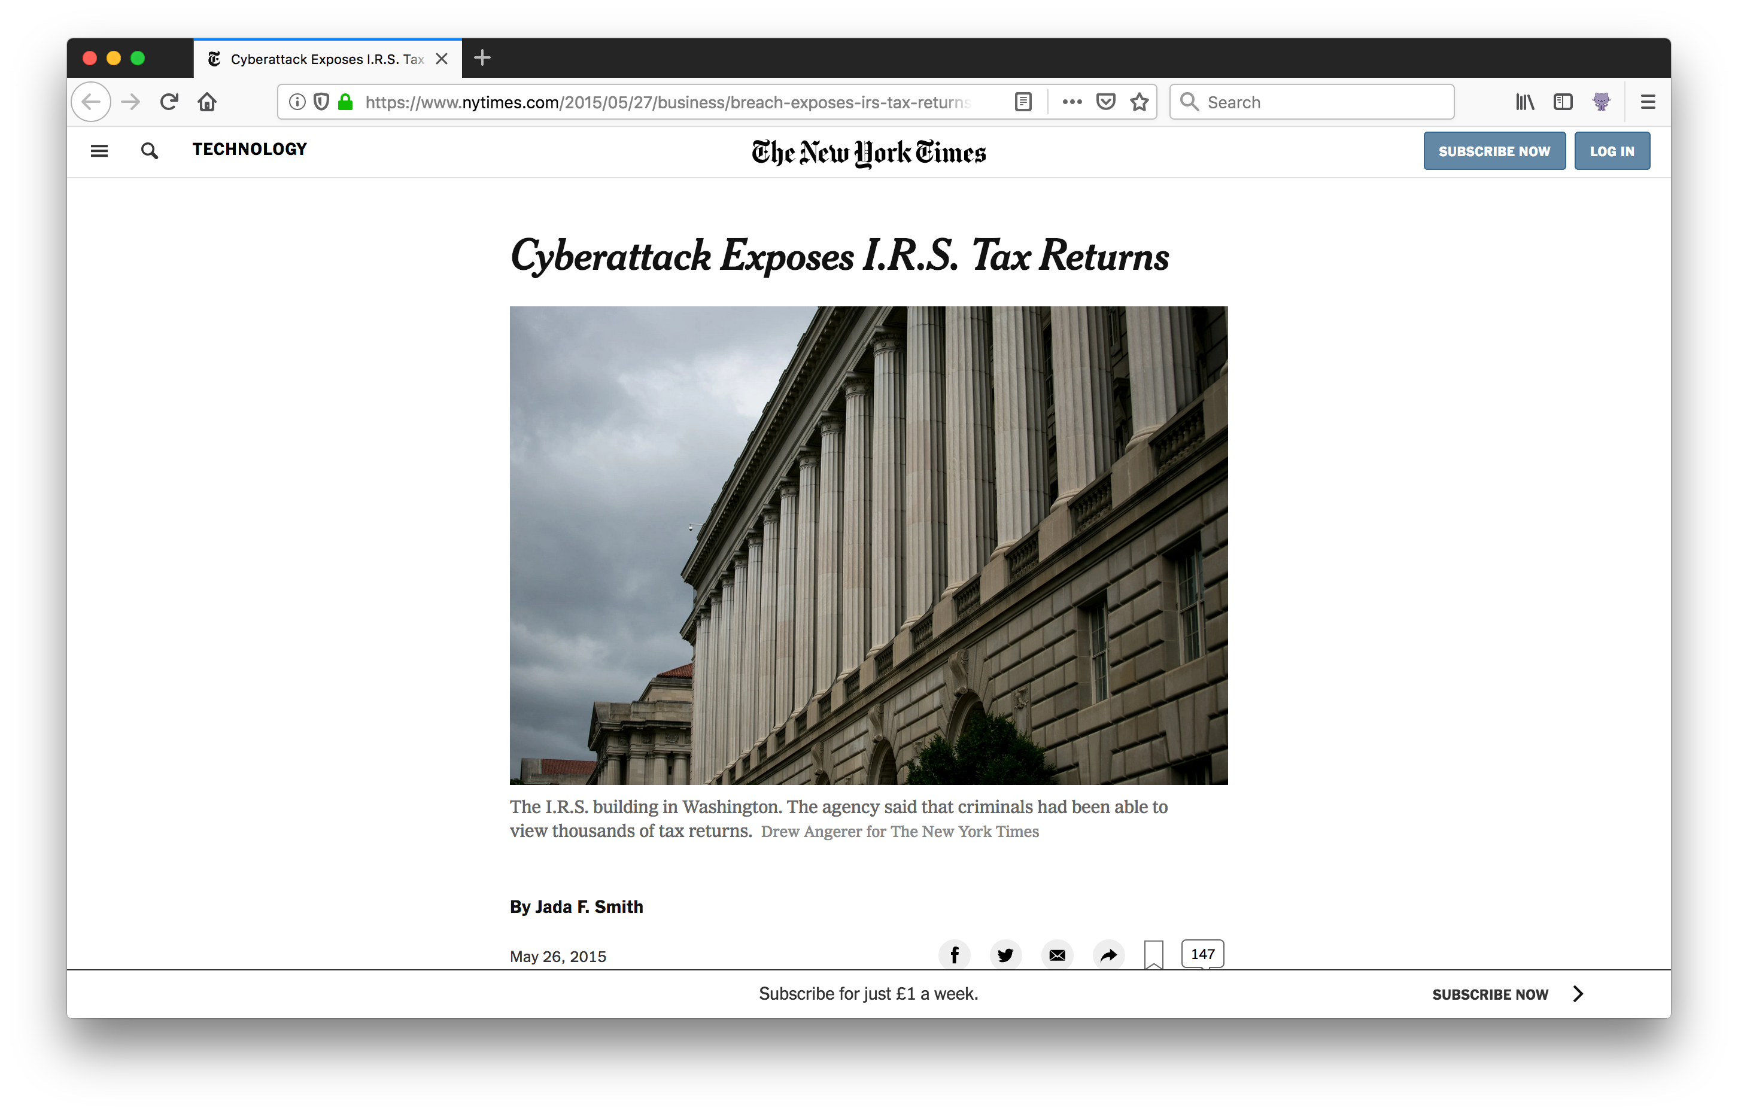
In 2015, the US IRS was breached.
The IRS did not have adequate access controls to prevent the ‘authenticated’ attackers impersonating legitimate users and manipulating the system.
The attackers were able to file fraudulent tax returns and received $50 million in government payouts before the attack was detected.

Slide 22
6. Security Misconfiguration
Covers a raft of different possible issues, from badly configured firewalls, unrestricted S3 bucket access, incorrect folder permissions, using default accounts or passwords, to displaying full stack traces in error messages.
In 2017, Accenture left 137 Gb of data, including 40,000 plaintext passwords, hashed passwords, access keys for the enStratus cloud infrastructure management platform, email data, and information on the consulting firm’s ASGARD database, exposed on an unrestricted AWS S3 bucket.
Also in 2017, Viacom left sensitive company data exposed in an S3 bucket, including the passwords and manifests for Viacom’s servers. The access key and secret key for the corporation’s AWS account were similarly stored in the repository.
As well as making sure resources are secured, disable unneeded administration interfaces. Disable debugging. Disable use of default accounts/passwords. Configure server to prevent unauthorized access, directory listing, etc.
Notes:
Estimated 7% of s3 buckets are unsecured
AWS Macie

Slide 23
7. Cross-Site Scripting (XSS)
Cross-Site Scripting (XSS) attacks are a type of injection, in which malicious scripts are injected into otherwise benign and trusted web sites.
XSS attacks occur when an attacker uses a web application to send malicious code, generally in the form of a browser side script, to a different end user.
An attacker can use XSS to send a malicious script to an unsuspecting user. The end user’s browser has no way to know that the script should not be trusted, and will execute the script. Because it thinks the script came from a trusted source, the malicious script can access any cookies, session tokens, or other sensitive information retained by the browser and used with that site. These scripts can even rewrite the content of the HTML page
Notes:
Cross-origin resource sharing (CORS) - same-origin policy

Slide 24

Challenge | Difficulty
Perform a reflected XSS attack with <iframe src="javascript:alert(xss)">.
Perform a DOM XSS attack with <iframe src="javascript:alert(xss)">.
Perform an XSS attack with <script>alert(xss)</script> on a legacy page within the application.
Perform a persisted XSS attack with <iframe src="javascript:alert(xss)"> bypassing a client-side security mechanism.
Perform a persisted XSS attack with <iframe src="javascript:alert(xss)"> without using the frontend application at all.
Perform a persisted XSS attack with <iframe src="javascript:alert(xss)"> bypassing a server-side security mechanism.
Perform a persisted XSS attack with <iframe src="javascript:alert(xss)"> through a HTTP header.

Slide 25
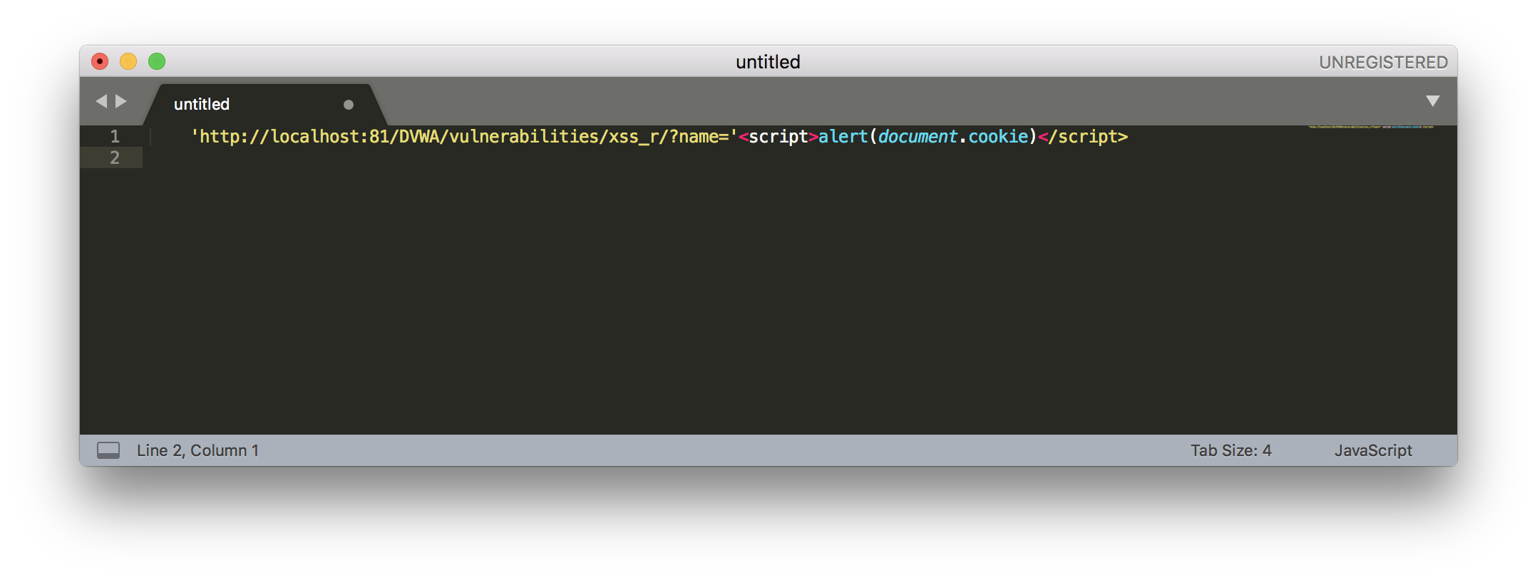
XSS example attack – session hijacking
By getting a user’s session cookie, it is possible to convince the server that you are that user
JavaScript code running in the browser can access the session cookies (when they lack the flag HTTPOnly) by calling document.cookie:

Slide 26
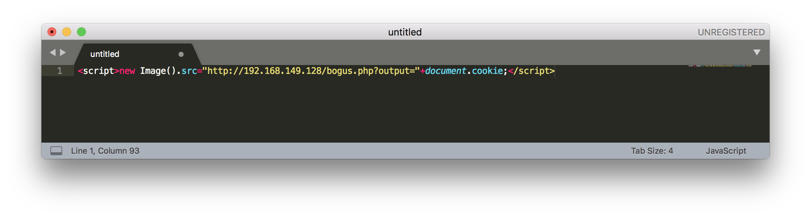
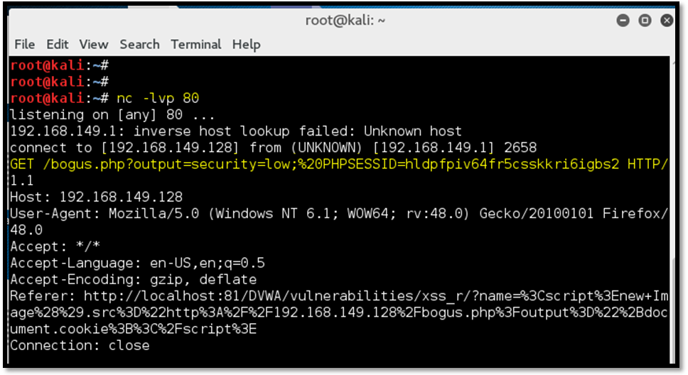
In order to steal the cookie, we provide a payload which will send the cookie value to the attacker-controlled website:
Listening on incoming connections on the attack server:

Slide 27
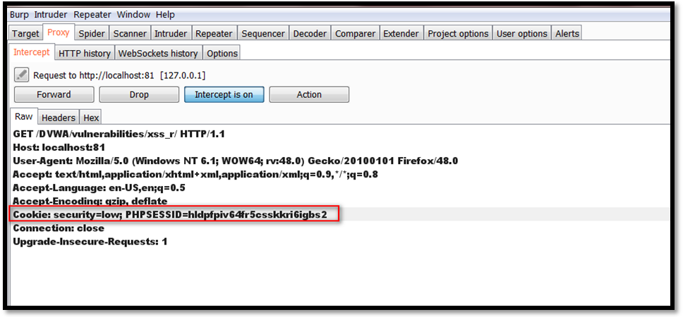
With the cookie information, it is now possible to access any internal page of the application and append the cookie value in the request, accessing that page on behalf of the victim: the user’s session has been hijacked

Slide 28
8. Insecure Deserialisation
Serialization refers to changing an object into a format that can be transmitted via an API or persisted on disk.
Deserialization is the reverse process – converting serialized data back into an object that can be used by the web application.
Safe deserialization of objects is normal practice in software development. The trouble however, starts when deserialising untrusted user input: An insecure deserialization vulnerability exists when an application doesn’t properly secure this process.
Successful insecure deserialisation attacks could allow an attacker to carry out denial-of-service attacks, authentication bypasses and remote code execution attacks.

Slide 29
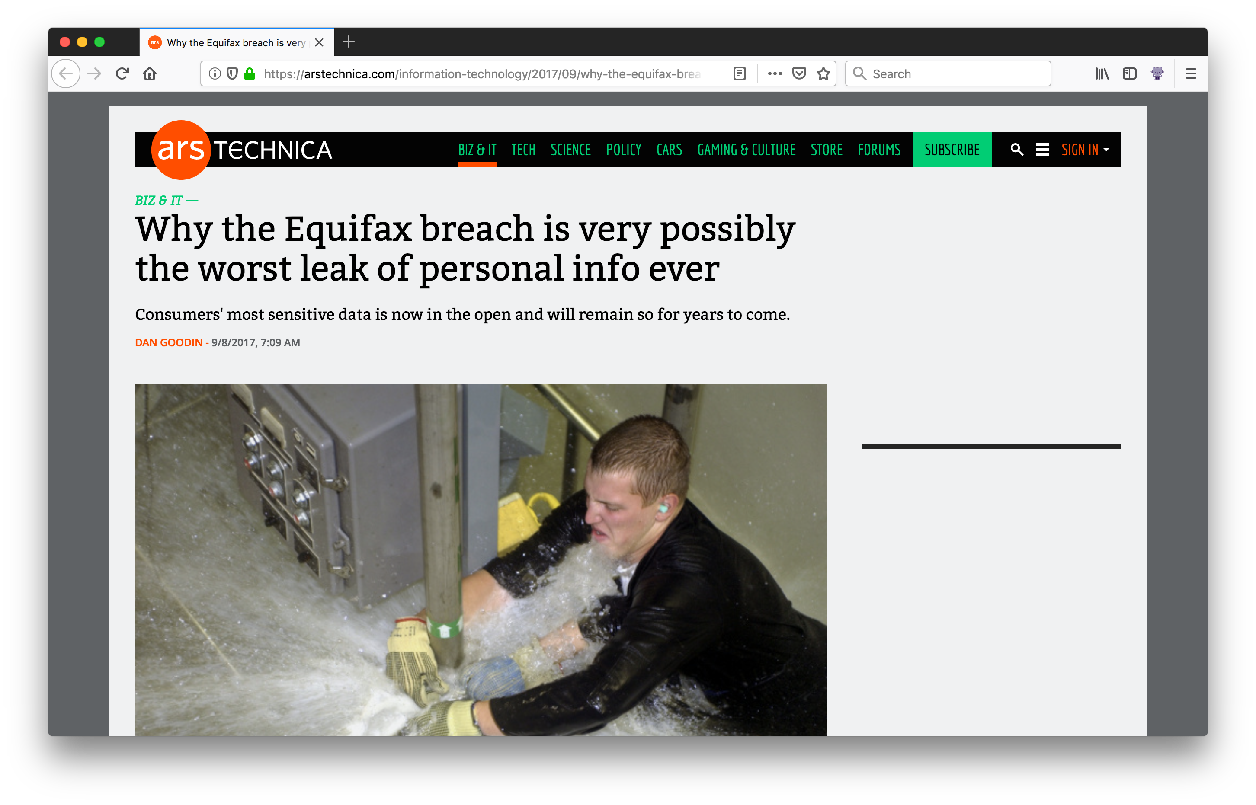
Example: Equifax breach 2017
A vulnerability in Apache Struts allowed insecure deserialisation of injected malicious code.
A patch had been released 2 months prior, but the application hadn’t been updated
143m people’s full names, Social Security numbers, birth dates, addresses, and, in some cases, driver license numbers were accessed.

Slide 30
How to discover Insecure Deserialization
Look at all deserializations.
1. Is any of the data from there on handled as trusted internal data, or is it correctly handled as user input? That would, for example, mean proper sanitisation before the deserialised data is used.
2. Is the data validated to actually be what is expected before being used? If a string is expected, make sure that a string and not an integer is received before the application continues.
Read up on the functions used for deserialization. The documentation often has security warnings about common mistakes. In several frameworks, there are multiple functions that can be used for serialization/deserialization and depending on the context it is important to choose the right one.

Slide 31
9. Using Components with Known Vulnerabilities
More and more apps are using pre-existing components rather than being coded completely from scratch.
As vulnerabilities are found, and published to places such as the Common Vulnerabilities and Exposure (CVE) list, it is important to establish and maintain a patch management schedule.
Components should be checked against the CVE list before use.
Tools such as Snyk and SonarQube can assist with this.
2012 Reuters website hack was down to an unpatched version of Wordpress.
Notes:
jQuery, Knockout, Modernizr, React, Angular, Node

Slide 32
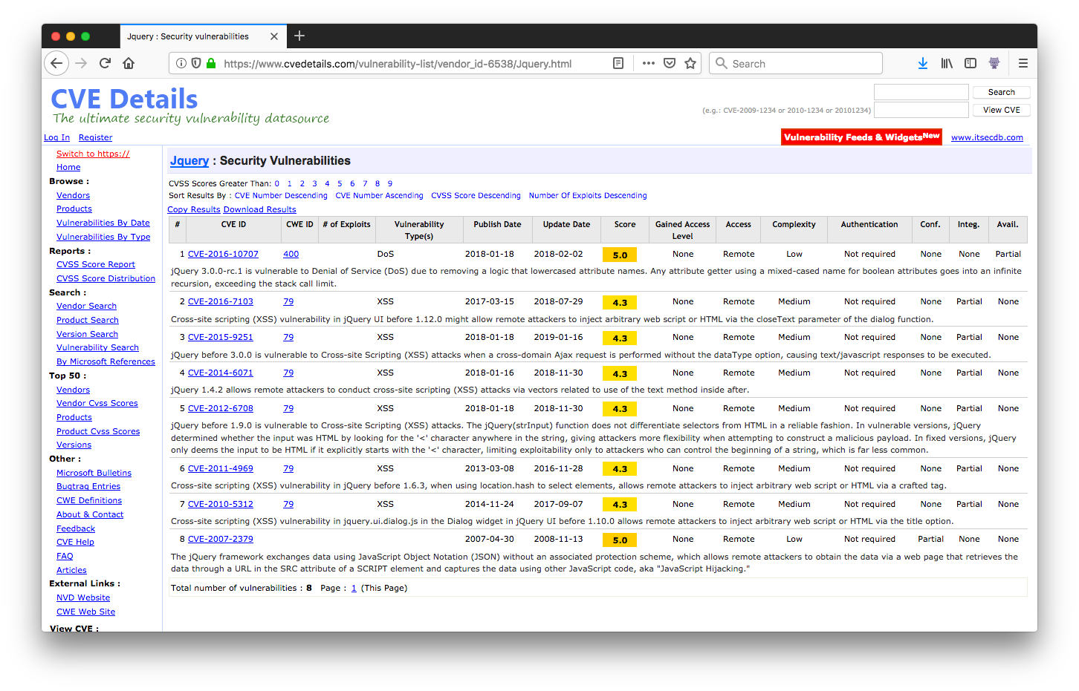

Slide 33
10. Insufficient Logging and Monitoring
Very hard to detect
One of the primary problems is that there are so many logs – almost all contemporary systems generate their own logs. Log management thus becomes a major problem.
By the time that all the different logs are gathered together and preferably collated, the sheer size of the data set becomes too large to effectively monitor manually.
Misconfiguration of the automated alerts, or lack of response to an alert, can hide serious issues
The problem is worsening with the rise of very sophisticated, sometimes state-sponsored attacks, that are specifically designed to be stealthy and not trigger alerts from installed logging and monitoring software, e.g. fileless attacks
Notes:
Just because your logging does not detect a problem does not mean that there is no problem
Fileless attacks will employ legitimate operating system software, such as PowerShell, that will not trigger monitoring software watching for unusual behavior.

Slide 34
Ensure all login, access control failures, and server-side input validation failures can be logged with sufficient user context to identify suspicious or malicious accounts, and held for sufficient time to allow delayed forensic analysis.
Ensure that logs are generated in a format that can be easily consumed by a centralised log management solution.
Use of log file analysis, e.g. ELK, can assist
Ensure high-value transactions have an audit trail with integrity controls to prevent tampering or deletion, such as append-only database tables or similar.
Establish effective monitoring and alerting such that suspicious activities are detected and responded to in a timely fashion.
Establish or adopt an incident response and recovery plan.
Pen test everything

Slide 35
The SANS / CWE Top 25 Most Dangerous Software Errors is a list of the most widespread and critical errors that can lead to serious vulnerabilities in software (please note: not all vulnerability types apply to all programming languages). The vulnerabilities include insecure interaction between components, risky resource management, and porous defenses.
Common Weakness Enumeration is a community-developed list of known software vulnerabilities: https://cwe.mitre.org/

Slide 36
OWASP | SANS / Common Weakness Enumeration
A1: Injection | CWE-78: Improper Neutralization of Special Elements Used in an OS Command (‘OS Command Injection’) CWE-89: SQL Injection CWE-94: Code Injection CWE-434: Unrestricted Upload of File with Dangerous Type CWE-494: Download of Code Without Integrity Check CWE-829: Inclusion of Functionality from Untrusted Control Sphere
A2: Broken authentication | CWE-306: Missing Authentication for Critical Function CWE-307: Improper Restriction of Excessive Authentication Attempts CWE-798: Use of Hard-coded Credentials CWE-807: Reliance on Untrusted Inputs in a Security Decision CWE-862: Missing Authorisation CWE-863: Incorrect Authorisation
A3: Sensitive Data Exposure | CWE-311: Missing Encryption of Sensitive Data CWE-319: Cleartext Transmission of Sensitive Information
A4: XML External Entities | None
A5: Broken Access Control | CWE-73: External Control of File Name or Path CWE-285: Improper Authorisation

Slide 37
OWASP | SANS / Common Weakness Enumeration
A6: Security Misconfiguration | CWE-250: Execution with Unnecessary Privileges CWE-676: Use of Potentially Dangerous Function CWE-732: Incorrect Permission Assignment for Critical Resource
A7: Cross-Site Scripting (XSS) | CWE-79: Improper Neutralization of Input During Web Page Generation (‘Cross-Site Scripting’)
A8: Insecure Deserialization | CWE-134: Use of Externally-Controlled Format String
A9: Using Components with Known Vulnerabilities | CWE-190: Integer Overflow or Wraparound CWE-327: Use of a Broken or Risky Cryptographic Algorithm CWE-759: Use of a One-way Hash Without a Salt
A10: Insufficient Logging and Monitoring | None

Slide 38
A1: Injection
CWE-78: Improper Neutralization of Special Elements Used in an OS Command (‘OS Command Injection’)
Applications are vulnerable to command injection if they use any form of outside input when running a command on the host system. Malicious input could cause the command to run in unexpected ways, potentially compromising the entire OS.
CWE-89: SQL Injection
SQL injection occurs when an application uses outside input as part of a SQL query. An attacker can use this to run any number of SQL commands on the database, resulting in data retrieval or manipulation.
CWE-94: Code Injection
Applications that execute user input as code are susceptible to code injection. An attacker can embed code as part of their input and the application will execute it.
CWE-343: Unrestricted Upload of File with Dangerous Type
Certain file types can be interpreted by the server as executable files. For example, a PHP server that accepts and runs .php files is open to an attacker uploading and running arbitrary PHP code.
CWE-494: Download of Code Without Integrity Check
Software that uses code from outside sources (such as a third-party library) without verifying its integrity is susceptible to code injection. For instance, if the server hosting the library suddenly starts delivering a different library instead, the application has no way of knowing that this change has occurred until the library has already been integrated.
CWE-829: Inclusion of Functionality from Untrusted Control Sphere
Similar to CWE-494, this involves using code from outside sources. However, in this case, the code can’t be trusted to perform the actions it claims to perform. For instance, if your website uses a script from an untrusted website, your entire website is exposed to any malicious activity that the external script may perform.

Slide 39
A2: Broken Authentication
CWE-306: Missing Authentication for Critical Function
Commands that perform privileged actions or interact with sensitive data should always require authentication. If the software ignores the authentication step, attackers can run privileged actions without having to verify their identity.
CWE-307: Improper Restriction of Excessive Authentication Attempts
If a user fails to authenticate multiple times in a short period, the application should prevent the user from retrying until a certain amount of time has passed. If not, an attacker can continuously try different credentials, resulting in a brute force attack.
CWE-798: Use of Hard-coded Credentials
Hard-coded credentials are often used during testing or when authenticating the application with another service. An attacker who finds these credentials can use them to log in to the service, access sensitive data, or impersonate the application.
CWE-807: Reliance on Untrusted Inputs in a Security Decision
Certain “hidden” fields (such as cookies, environment variables, and hidden form fields) can be modified to contain values other than those expected by the application. Attackers can change these fields to fool or bypass security steps such as authentication or session management.
CWE-862: Missing Authorization
When performing any privileged action, the application should always perform an authorization check on the user that requested the action. Failing to do so can allow unprivileged users to access secure data or perform dangerous actions.
CWE-863: Incorrect Authorization
Authorization checks that aren’t properly implemented can be tricked or bypass by attackers.

Slide 40
A3: Sensitive Data Exposure
CWE-311: Missing Encryption of Sensitive Data
Sensitive data should be encrypted while in transit and while at rest. This way, anyone who accesses it won’t be able to see sensitive data without the decryption key.
CWE-319: Cleartext Transmission of Sensitive Information
Expanding on CWE-311, data should also be encrypted while being sent over a communication channel such as a network. Data sent over a network can be read by a third-party, meaning any unencrypted data can be read by an attacker.
Notes:
Transport layer security

Slide 41
A5: Broken Access Control
CWE-73: External Control of File Name or Path
User input should not be used to locate files on the server. Allowing user input to determine the path can result in the user accessing sensitive files.
CWE-285: Improper Authorization
Similar to CWE-863, improper authorization allows users to run commands without confirming the user’s identity. This occurs when an attacker performs an action that should require an authorisation check, but doesn’t.
Notes:
chroot jail

Slide 42
A6: Security Misconfiguration
CWE-250: Execution with Unnecessary Privileges
Applications should perform operations with the minimum necessary permissions. For example, writing to a file as an administrator instead of a normal user makes it possible to overwrite critical application and system files.
CWE-676: Use of Potentially Dangerous Function
Some functions can have negative effects when used incorrectly, allowing attackers to access system resources or cause errors.
CWE-732: Incorrect Permission Assignment for Critical Resource
Operations that create and manage resources (such as files) must assign the correct permissions to those resources. Failing to do so could allow unintentional access by other users.
Notes:
Should never see global read write execute permissions. 755 should be plenty enough for anyone.
Cwe-676: thread.stop – terminates running thread, can lead to corruption of data that was mid-process.

Slide 43
A7: Cross-Site Scripting (XSS)
CWE-79: Improper Neutralization of Input During Web Page Generation (‘Cross-Site Scripting’)
Cross-site scripting (XSS) occurs when an attacker submits input that the application then renders as output. If the input contains code (such as JavaScript), that code will be executed in the browser that the page renders in.

Slide 44
A8: Insecure Deserialization
CWE-134: Use of Externally-Controlled Format String
Externally-controlled format strings can allow attackers to cause runtime errors or even write to the stack. Programs should only use static format strings from external sources.
Notes:
E.g. a string provided as an argument, but the format string originates from an external source. The string can be formatted so that a printf will overflow the buffer

Slide 45
A9: Using Components with Known Vulnerabilities
CWE-190: Integer Overflow or Wraparound
An integer overflow occurs when the value of a variable is too large for its type, causing it to “wrap around” to the type’s lower limit. This can have unexpected consequences in several operations including basic arithmetic, control looping, and memory operations.
CWE-327: Use of a Broken or Risky Cryptographic Algorithm
Cryptographic algorithms that are known to be insecure have several possible attack vectors. Using an insecure algorithm opens your application to these attacks, whereas more secure algorithms are less likely to be vulnerable.
CWE-759: Use of a One-way Hash Without a Salt
A salt is a random string used to improve security when hashing data such as a password. Without a salt, hashes can be reverse engineered more easily using brute force or rainbow tables.
Notes:
SHA-1 has been broken with an estimated cost of $2.77M of cloud resources to break a single hash value

